Slide 1
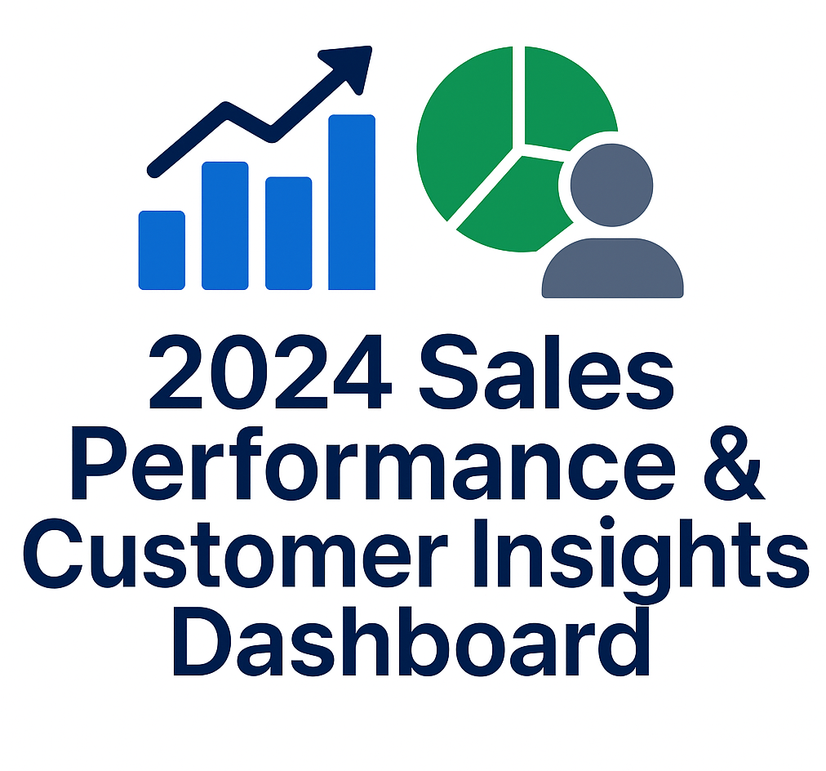
2024 Sales Performance & Customer Insights
Data-driven analysis of revenue, customers, and markets
Inette Badenhorst
2025/12/13
Notes:
“Today I’ll be walking you through our 2024 sales performance and customer insights.
The objective of this analysis is to understand overall sales results, identify what is driving revenue, and highlight opportunities to improve performance going forward.
All insights are based on transactional sales data summarized in this dashboard.”

Slide 2
Executive Summary
R3,202.59 revenue generated from 200 orders in 2024.
• Seasonal Revenue spike in September.
• Revenue highly concentrated among top customers.
• UK leads in both revenue and unique buyers.
Notes:
“To summarize the year, total sales in 2024 reached R3,202.59 from 200 orders.
Revenue peaked strongly in September, indicating seasonal or campaign-driven demand.
Sales are highly concentrated, with a small group of customers contributing a large portion of revenue.
From a geographic perspective, the UK stands out as the strongest market, leading in both revenue and number of unique buyers.
These patterns highlight strong performance, but also areas of risk and opportunity.”

Slide 3
OVERALL SALES PERFORMANCE- 2024
Total Revenue
R3202,59
Total Orders
200
AOV
R 16,01
Revenue By Country
UK 25%
Sales performance shows strong revenue but reliance on a limited customer base.
Notes:
“This slide shows our key performance indicators for the year.
We achieved total revenue of R3,202.59 across 200 orders, resulting in an average order value of approximately R16.01.
The UK accounts for the largest share of revenue at 25%, reinforcing its importance as our core market.
While overall performance is positive, the KPIs suggest reliance on specific markets and customers, which we explore further in the following slides.”

Slide 4
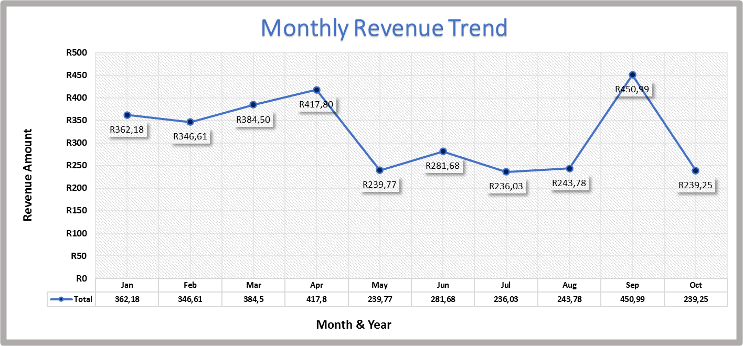
Monthly Revenue Trend (2024)
📈
Revenue peaked in September, followed by a decline, suggesting seasonal demand and potential promotion-driven spikes.
Notes:
“Here we see the monthly revenue trend across 2024.
Revenue remains relatively stable for most of the year but shows a significant spike in September.
This peak suggests seasonal demand or the impact of targeted promotions.
Following September, revenue declines, which indicates volatility rather than consistent growth.
This pattern highlights the need to smooth revenue across the year through better demand planning or off-peak promotions.”

Slide 5
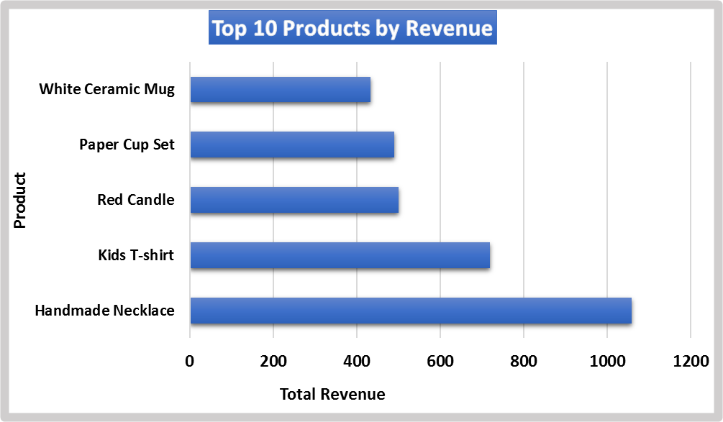
Top Revenue-Generating Products
🏆
Revenue is driven primarily by a small number of top-performing products, indicating opportunities for focused inventory and marketing strategies.
Notes:
“This chart highlights the top 10 products ranked by revenue contribution.
We can clearly see that a small number of products generate the majority of total sales.
This concentration suggests that these products are critical revenue drivers and should be prioritized in inventory, marketing, and pricing strategies.
At the same time, it presents an opportunity to improve performance of lower-ranking products through bundling or targeted promotions.”

Slide 6
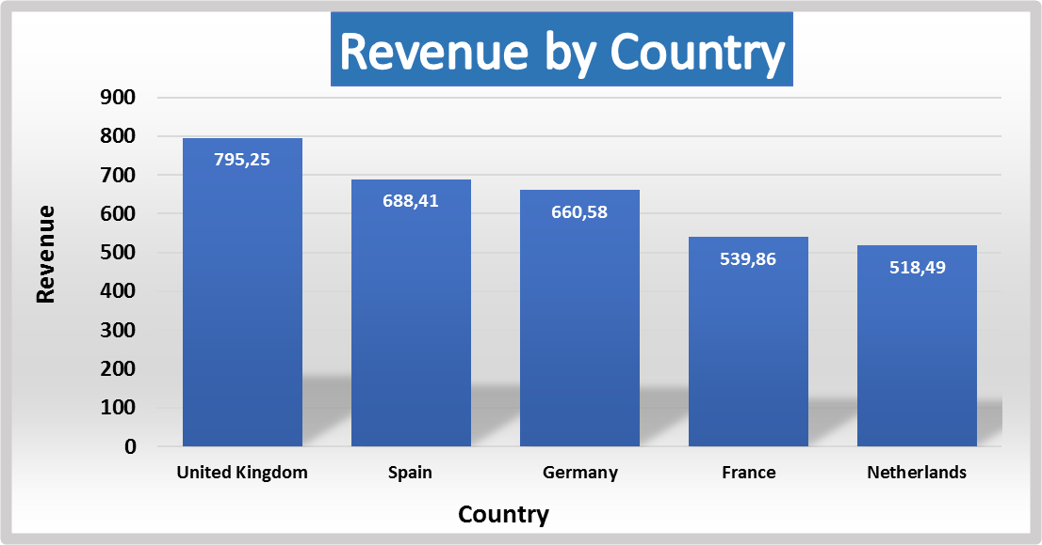
Revenue by Country
🌍
The UK leads in revenue contribution, followed by Spain and Germany, making it the strongest target market for expansion.
Notes:
“This slide breaks down revenue by country.
The United Kingdom leads in revenue contribution, followed by Spain and Germany.
France and the Netherlands generate lower but still meaningful revenue levels.
The dominance of the UK market suggests strong product-market fit, while other countries represent growth opportunities if supported with localized marketing and sales strategies.”

Slide 7
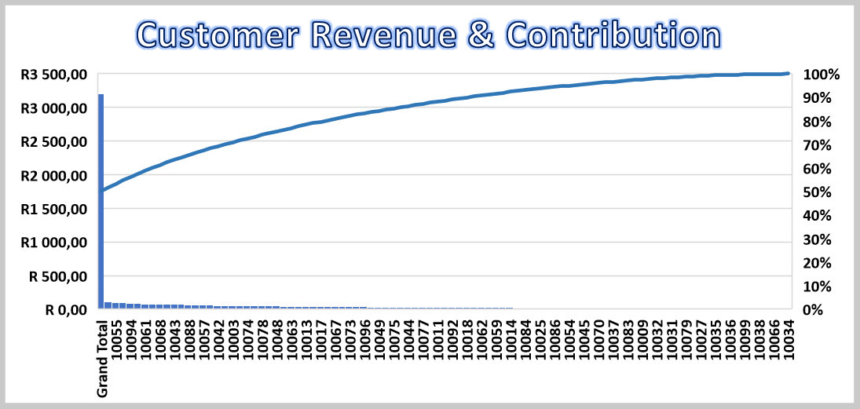
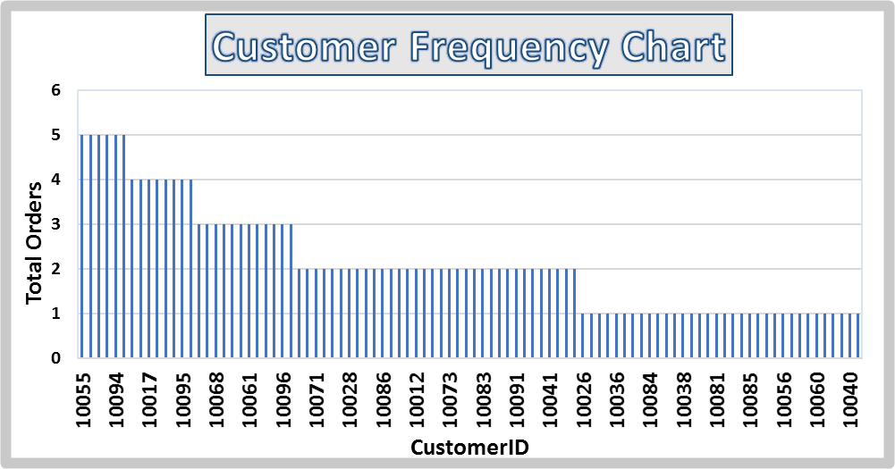
Customer Concentration Analysis
👥
A small group of customers contributes a disproportionately large share of total revenue, creating dependency risk.
Notes:
“This slide focuses on customer behavior and revenue concentration.
The customer frequency chart shows that many customers place only a small number of orders.
The Pareto-style contribution chart reveals that a small percentage of customers contribute a large share of total revenue.
This creates dependency risk, as losing a few high-value customers could significantly impact overall sales.
It highlights the importance of retention strategies and customer relationship management.”

Slide 8
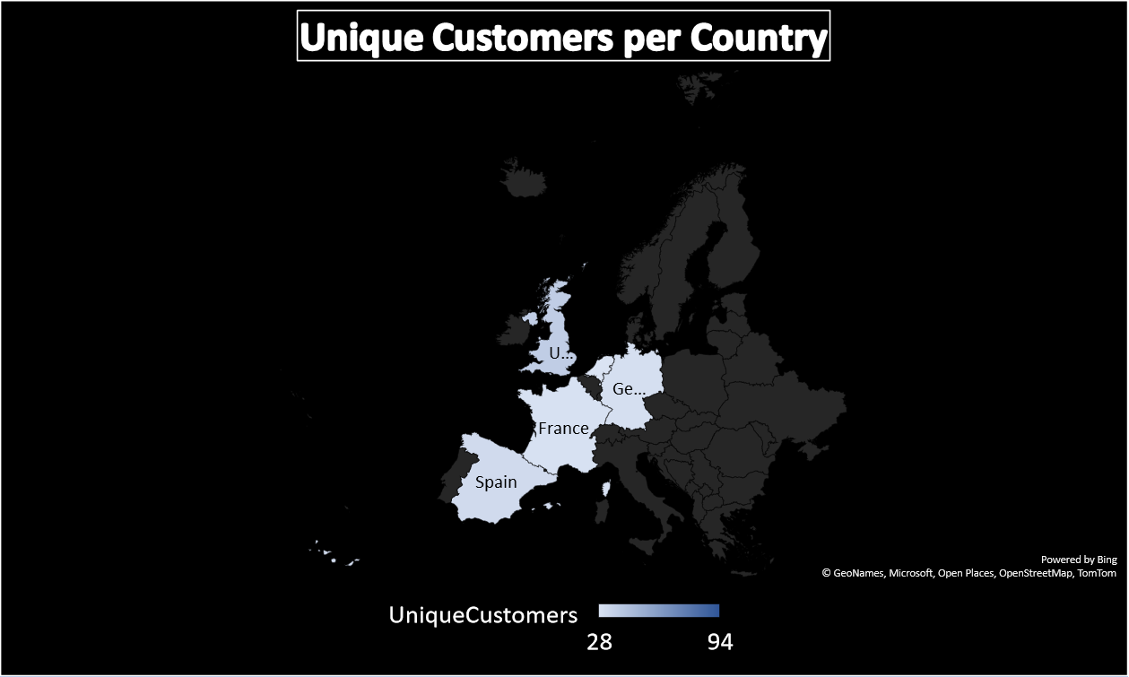
Unique Customers by Country
🗺
The UK has the highest number of unique customers, reinforcing its importance as the core market.
Notes:
“This map shows the number of unique customers by country.
The UK has the highest number of unique customers, aligning with its strong revenue performance.
Spain, Germany, France, and the Netherlands follow with smaller customer bases.
This confirms that revenue strength in the UK is driven not only by high-value orders but also by a larger customer base.”

Slide 9
Key Insights:
Revenue is seasonal, peaking in September.
Sales are highly concentrated among top customers.
Product revenue is driven by a small subset of SKUs.
UK dominates both revenue and customer count
Notes:
“Bringing all insights together, several key themes emerge.
Revenue shows seasonal volatility, with a strong September peak.
Sales are highly concentrated across top customers and top products.
Geographically, the UK dominates both revenue and customer volume.
These insights point to strong performance, but also underline risks related to concentration and seasonality.”

Slide 10
Recommendations & Next Steps:
Recommendations:
Strengthen customer retention to reduce revenue dependency.
Introduce off-peak promotions to smooth seasonal volatility.
Expand localized marketing in the UK.
Bundle or promote mid-tier products to diversify revenue.
Next Steps:
Monitor customer churn monthly.
Track product performance post-promotion.
Expand customer acquisition in top regions
Notes:
“Based on these findings, several actions are recommended.
First, strengthen customer retention strategies to reduce dependency on a small group of high-value customers.
Second, introduce targeted promotions during lower-performing months to smooth seasonal revenue fluctuations.
Third, continue to invest in the UK market through localized offers and marketing efforts.
Finally, focus on expanding sales of mid-performing products to diversify revenue streams.
These steps will support more stable and sustainable growth moving forward.”

